Slide 1
Single Working Parent
Tara Baker
Notes:
This lesson is used with NTTC Workbook Exercise Tara Baker. It covers the following tax topics: Head of Household filing status, Qualifying Child Dependent, Income (alimony, gambling winnings, and cancellation of debt), Adjustments (Early Withdrawal Penalty), Credits (Child Tax Credit, Child and Dependent Care Credit, and Earned income Credit). The class will also get additional practice with Wages (W-2) and Interest (1099-INT).
Information for conducting this training lesson is contained in the Instructor Guide for Tax-Aide National Tax Training Committee Workbook (Workbook Instructor Guide).
Instructors should add, delete, or modify slides as necessary to meet their district training needs.
Instructors should direct the volunteers to review appropriate section of the Counselor Resource Guide (Pub 4012) whenever possible. If volunteers wish to take notes during class, they should note that Pub 4012 is a good place to record them.
Slides at the end of this presentation provide instructions for entering information for the various tax topic into TaxSlayer. Pub 4012 Tab O is emphasized as the best source for information on entering information into the software.

Slide 2
Single Working Taxpayer
This lesson will focus on a tax return for a typical single parent taxpayer
The following tax topics will be discussed:
Head of Household (HoH) Filing Status
Income: Disability, Alimony, Gambling Winnings, and Cancellation of Debt
Adjustments: Early Withdrawal Penalty
Credits: Child Tax Credit, Childcare Credit, Retirement Savings Credit, and Earned Income Credit (EIC)
Additional Practice: Wages and Interest

Slide 3
Five Choices for Filing Status
Single
Married filing jointly (MFJ)
Married filing separately (MFS)
Head of household (HoH)
Qualified widow(er) (QW)
For this lesson only Head of Household will be discussed
Notes:
Head of Household Filing Status: Filing status that applies to a taxpayer who provides a home for a qualifying person. The taxpayer may be single or in some cases legally married.

Slide 4
Filing Status: Head of Household – Unmarried
Provided home* for qualified child
Might not be a dependent
Provided home* for related dependent
>50% cost of maintaining home for dependent parents living elsewhere
* Paid more than 50% of cost of keeping up the home
Notes:
The trifold laminate can be helpful in determining head of household filing status.

Slide 5
Filing Status: Head of Household – Married
Lived apart all of last 6 months of year
Provided home* for:
Child, stepchild, or eligible foster child for over six months
No other relatives qualify
* Paid more than 50% of cost of keeping up the home

Slide 6
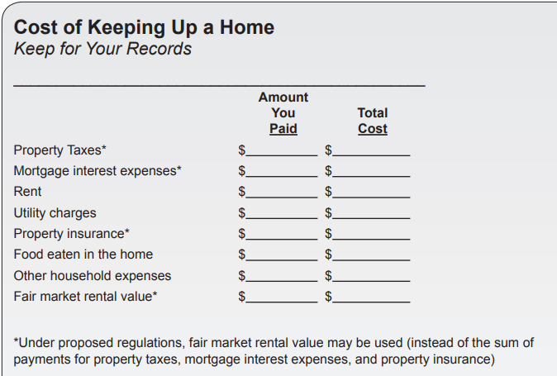
Filing Status: Head of Household – Providing a Home
Open Pub 4012
To Page B-11
Rule change – use rental Fair Market Value
May provide simpler computation

Slide 7
Filing Status: Head of Household - Advantages
Key advantages
Higher standard deduction than Single or MFS
Advantageous tax rate structure

Slide 8
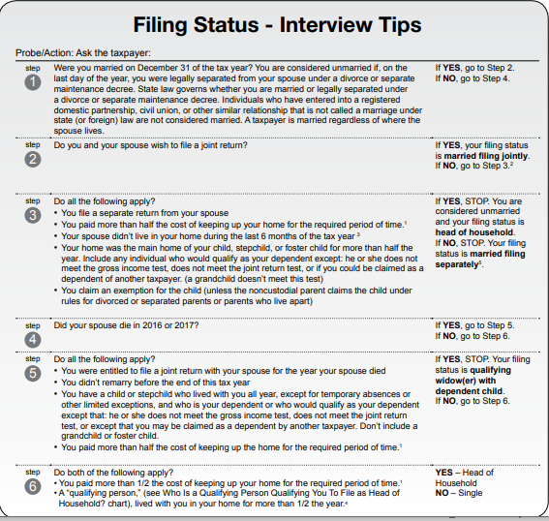
Filing Status: Interview Tips
Open
Pub 4012
to Pages B-9 and B-10
Don’t miss
the
footnotes
Married
Unmarried
Notes:
Direct student to open Pub 4012 to Page B-7 and then lead the discussion
Don’t miss the footnotes

Slide 9
Questions
Answer Baker questions 1 - 3

Slide 10
Dependent Exemption
Person other than taxpayer or spouse who entitles taxpayer to exemption:
Qualifying child (which also includes adult with disability)
OR
Qualifying relative (which also includes qualifying non-relatives)
For this lesson only Qualifying Child will be discussed
Notes:
In this lesson only the Qualifying Child will be addressed

Slide 11
Intake and Interview
Ask: Who else lived with you?
Who else did you support?
Counselors are required to determine the answers to all question in the grey boxes and record them on the Intake/Interview Sheet
Notes:
Instructors must stress the importance of the interview to determine dependent status and to reinforce the requirement to complete the shaded area on the I/I Sheet

Slide 12
Dependency Exemption Rules
Open Pub 4012 to Page C-3
Examine the general rules at the top

Slide 13
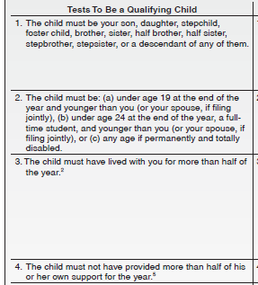
Qualifying Child - Tests
Continue to examine Pub 4012 Page C-3
Review the Tests To Be a Qualifying Child
Also examine Tab C Table 1 for an interview guide for these tests
Notes:
The Instructor should lead the discussion as the class “walks down” the steps. After the review of the tests direct the class to Table 1 and point out the tests in an Interview format.

Slide 14
Qualifying Child – Terms
Permanently and totally disabled
Person cannot engage in any substantial gainful activity because of a physical or mental condition -AND-
Doctor determines condition has lasted or can be expected to last continuously for at least a year or can lead to death
Volunteers are not required to see documentation; however, the taxpayer needs to understand that a physician certification is required
Notes:
Note that this situation is often encountered with an adult relative who meets this test and is therefore classified as a Qualifying Child.
A person can have a disability and not be considered “permanently and totally disabled”. A doctors determination is required.

Slide 15
Qualifying Child - Terms (cont)
Student
A full-time student during some part of each of any five calendar months of the year
Full-time is the number of hours or courses the school considers to be full-time
Attending a school that has a regular teaching staff, course of study and student body at the school
Does NOT include on-the-job training course, correspondence school, or school offering courses only through the Internet

Slide 16
Qualifying Child - Terms (cont)
Temporary absence
Circumstances such as illness, education, business, vacation, or military service
Now includes: Incarceration and Institutionalized care for a child who is permanently and totally disabled
Must be reasonable to assume the absent person will return
Must continue to keep up the home during the absence

Slide 17
Questions
Answer Baker questions 4 and 5

Slide 18
Income: Pension Distribution - Disability Box 7 Code 3
Reported on 1099-R with a Code of 3 in Box 7
Until taxpayer reaches employer’s minimum retirement age
Disability payments taxed as wages
Reported on 1040 Line 1, eligible for Earned Income Credit
Once retirement age is reached
Disability payment taxed as pension
Reported on 1040 Line 4d
Taxpayer does not start to recover their contributions until it is taxed as a pension (covered more in Davenport problem)
Notes:
Ask the taxpayer what that employer’s minimum retirement age is for the plan.

Slide 19
Entry of Disability in TaxSlayer
For Form 1099-R check the box near the bottom of the 1099-R input page if recipient is under minimum retirement age

Slide 20
Income: Alimony Received
What is Alimony?
Spousal support under separation or divorce instrument
Usually stops if recipient remarries, may stop sooner
Not subject to change based on factors such as age of a child
Child/family support is NOT alimony
See Pub 4012 Page E-8 for more details
Pub 4012 Page E-5
Notes:
Ask participants to open their pub 4012 to the Alimony Requirements section of Tab E
Top chart addresses alimony expense
Alimony is income only when the payment is a deductible expense
Note that divorces after December 31 2018, the payee will no longer have to report alimony as income (and the payer will not deduct payments as an adjustment to gross income)

Slide 21
Income: Alimony Received
Where do I get information about alimony received?
Intake/Interview Sheet Part III Question 6
Taxpayer needs to provide information of actual amount received in the current tax year
Look at prior year return

Slide 22
Income: Alimony Received
Not earned income for EIC
Not earned income for child tax credit
Not earned income for dependent care credit
But IS “compensation” for IRA Contributions

Slide 23
Adjustments: Alimony Paid
Where do I get information on alimony paid?
Intake/Interview Sheet Part IV Question 1
Taxpayer needs to provide actual amount paid in the current tax year and Social Security # of recipient
Look at prior year return

Slide 24
Tax Law Change Regarding Alimony
Divorce agreement executed prior to 1/1/2019
Person receiving alimony must claim as income
Person paying alimony can receive adjustment to income deduction
Divorce agreement executed/modified as of 1/1/2019 or later
Person receiving alimony does not have to claim as income
Person paying alimony does not receive adjustment to income deduction
If modification, must specifically state it will be under new rules

Slide 25
Income: Other
Covers a variety of income other than wages, retirement, and investment income
Review Other Income Section in Pub 4012 Tab D
Examples include:
Reported on 1099-MISC, Box 3
Reported on 1099-MISC, Box 7 – but “not a business”
Gambling winnings including lotteries and raffles
Taxable amount of long term care (1099-LTC)
Cancellation of debt (1099-C)
Notes:
This lesson covers Gambling winnings and cancellation of credit card debt

Slide 26
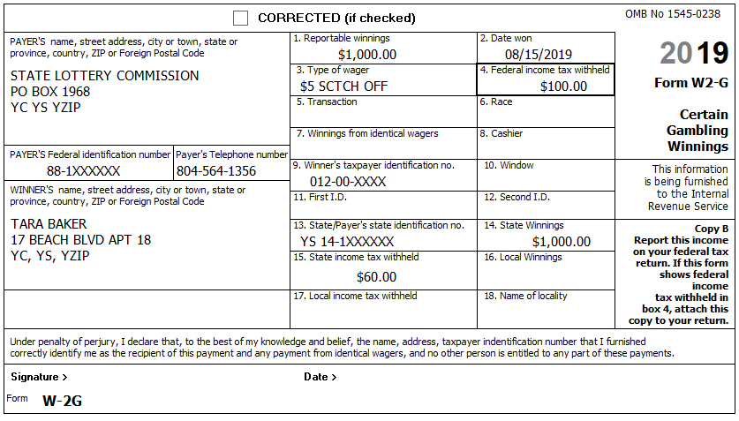
Income: Other - Gambling Winnings
Normally reported on Form W-2G
Gambling losses can be deducted only if the taxpayer itemizes (Schedule A) – can claim up to amount of winnings

Slide 27
Income: Other – Cancellation of Debt
Cancellation of debt is in scope for credit card debt
Other debt such as car loans, student loans, or other consumer installment loans is out of scope
Lenders must issue Form 1099-C if they cancel $600 or more of debt
Less than $600 must still be reported as income by taxpayer
Canceled debt income is reported as “Other Income”
Notes:
The Instructor should direct the class to the screening sheet in Pub 4012 and discuss the solvency issue.
Note that home mortgage debt is not discussed with new volunteers. It is a comprehensive topic.

Slide 28
Income: Other – Cancellation of Debt
Credit card debt – nonbusiness only
Taxpayer must be solvent immediately before debt canceled
Value of assets exceeds total amount of liabilities
Not in bankruptcy
Review the Screening Sheet in Pub 4012 Page D-63
Otherwise out of scope
Notes:
Generally, if a debt for which a taxpayer is personally liable is canceled or forgiven, the taxpayer must include the canceled amount in income. There is no income from canceled debt if the cancelation or forgiveness of debt is a gift or bequest.

Slide 29
Income: Other – Cancellation of Debt - Form 1099-C

Slide 30
Questions
Answer Baker questions 6 - 9

Slide 31
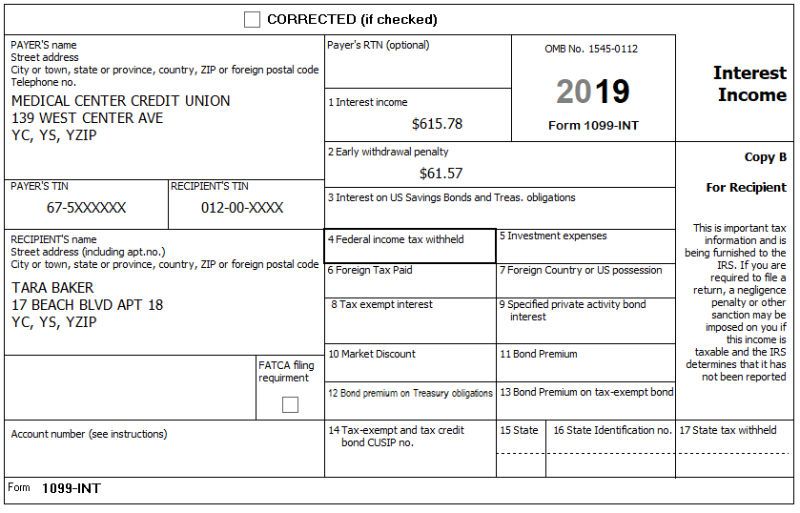
Adjustments: Early Withdrawal Penalty
Penalty for withdrawal of funds from time deposits
Reported on 1099-INT or 1099-OID
Entered on TaxSlayer interest page and will be carried to adjustments

Slide 32
Credits: Child Tax Credit
Review Pub 4012 Tab G
Must be claimed as your dependent
Mus be qualifying child, not qualifying relative
Under age 17
U.S. citizen, national or resident alien
Child must have a Social Security # before due date of return
Subject to AGI phase out (rare for those taxpayers we serve)
Notes:
Direct class to the Child Tax Credit Section of Tab G in Pub 4012 and have them review the requirements including the Interview Sheet
Canadian or Mexican citizen or resident doesn’t count.

Slide 33
Credits: Child Tax Credit – Two Credits
#1: Child Tax Credit
Nonrefundable
If no tax liability amount on 1040 Line 16, will go to a Refundable credit
Up to $2,000 per qualifying child
#2 Additional Child Tax Credit
Refundable
Maximum Credit
Up to unused portion of child tax credit
Limited to $1,400

Slide 34
Credits: Child Tax Credit Child of Divorced Parents
Must be a dependent, so if dependency goes to noncustodial parent then so does CTC
Review footnotes on Pub 4012 Pages G-2 and G-3 for more information
See also Form 8332 (Release of Claim to Exemption for Child by Custodial Parent)

Slide 35
Credits: Child and Dependent Care Credit
A non-refundable credit
Review Pub 4012 Pages G-10 through G-14
Taxpayer must provide receipt for expenses with required information for the return
Must live with taxpayer half the year, so in case of a divorce, credit goes to custodial parent (if he or she paid the expense)
Notes:
Direct class to the Child and Dependent Care Credit section of Pub 4012 Tab G and discuss “Who is a qualifying person” and “What are qualifying expenses”
Have the class “Walk down” the Decision Tree.

Slide 36
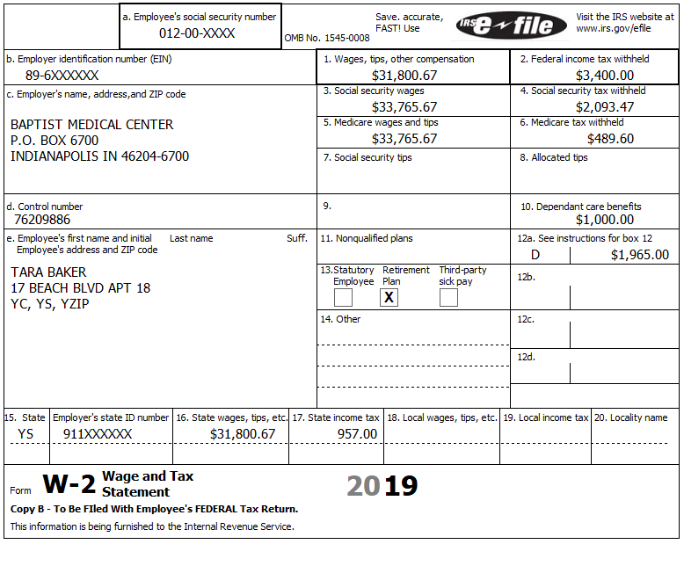
Credits: Child and Dependent Care Credit
Employer-Provided Benefits
Reported in Box 10 on the W-2
TaxSlayer automatically carries to Form 2441
Reported as other income if more than actual expenses

Slide 37
Credits: Child and Dependent Care Credit
Below kindergarten okay
After school okay if not educational
Day camp okay, overnight camp not OK
Adult day care okay
In-home care okay
Care may also qualify as medical deduction – same amount can be used for one or the other, no double dipping
Notes:
Kindergarten used to be included. It was removed a few years ago.
Some in-home care may be used as either medical expense or dependent care—not both.
Wages and employment taxes for household employee is an allowed expense; however, it is out of scope.
Household services that are at least partly for the well-being and protection of a qualifying person are ok. [includes housekeeper, maid, or cook—but not a chauffeur or gardener]
From Instructions to Form 2441:
Care includes the cost of services for the qualifying person's well-being and protection. It does not include the cost of food, lodging, education, clothing, or entertainment.
You can include the cost of care provided outside your home for your dependent under age 13 or any other qualifying person who regularly spends at least 8 hours a day in your home. If the care was provided by a dependent care center, the center must meet all applicable state and local regulations. A dependent care center is a place that provides care for more than six persons (other than persons who live there) and receives a fee, payment, or grant for providing services for any of those persons, even if the center is not run for profit.
You can include amounts paid for items other than the care of your child (such as food and schooling) only if the items are incidental to the care of the child and cannot be separated from the total cost. But do not include the cost of schooling for a child in kindergarten or above. You can include the cost of a day camp, even if it specializes in a particular activity, such as computers or soccer. But do not include any expenses for sending your child to an overnight camp, summer school, or a tutoring program.

Slide 38
Credits: Child and Dependent Care Credit - Caregiver
Cannot be spouse or dependent
Cannot be taxpayer’s child who is under age 19
Cannot be child’s parent (with some exceptions for adults needing care)
Taxpayer must make reasonable effort to get provider’s name, address and identifying number
Notes:
If you can’t get the EIN, SSN or ITIN for the provider you cannot e-file and must complete an explanation on the back of Form 2441.
If caregiver is your employee, and total payments were more than $2000, then Schedule H for household employees is required, and return is out of scope.

Slide 39
Credit: Earned Income Credit (EIC)
A refundable credit can generate a refund even if the taxpayer didn’t pay any money in
Review Pub 4012 Tab I
Review the EIC Eligibility Rules
Review the Interview Sheets
General Rules
EIC with Qualifying Child
EIC without a Qualifying Child
TaxSlayer will automatically calculate EIC based on the relevant information entered for the return, so accurate personal info very important, especially birth dates
Notes:
Even if there is no tax liability (i.e. the taxpayer owes no money), the taxpayer can still receive a check from the IRS.
Direct the class to Pub 4012 Tab I and lead a discussion on the rules for EIC and stress that the calculation will be based on the information entered in the return so accurate personal information, especiall birthdates are important

Slide 40
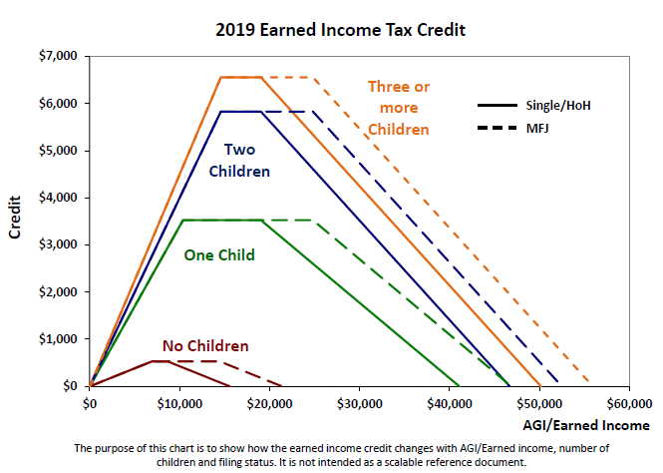
Credit: EIC - Amount of the Credit

Slide 41
Questions
Answer Baker questions 10 - 13

Slide 42
Single Working Parent – NJ Considerations
This section will focus on NJ aspects of a simple tax return for a typical single parent taxpayer
The following tax topics will be discussed:
W2 Box 14 - Disability Private Plans (PPs)
Flexible Savings Account (FSA)/Health Savings Account (HSA) Distributions
Disability Pension
Gambling Winnings
Cancellation of Debt
EIC Considerations for NJ

Slide 43
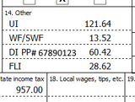
W2 Box 14 - Disability Private Plans (PPs)
In lieu of state provided disability insurance, companies have the option of providing a private disability insurance plan instead
Box 14 format: DI PP# 123456
When entering PP in TaxSlayer in Box 14, still choose “NJSDI” from drop-down menu
TaxSlayer automatically carries amount to Schedule A State Taxes Paid

Slide 44
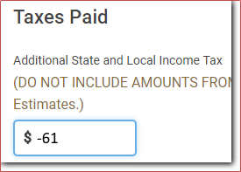
W2 Box 14 - Disability Private Plans (PPs)
Since PPs are not paid to a government, not considered “state tax”; therefore, cannot be claimed on Schedule A
Must back out PP amount from Schedule A
Navigate to Itemized Deductions / Taxes You Paid
Enter the PP amount in “Additional State and Local Tax” field as a negative amount or subtract from an existing entered amount
TaxSlayer
Itemized Deductions Menu

Slide 45
W2 Box 14 - Entering Private Plan Numbers
The private plan number needs to be reported for the NJ return
Using the NJ Checklist, record the W2’s EIN and PP Number in the “Payments” section (bottom of page 2)

Slide 46
FSA/HSA Distributions
For Federal returns, FSA and HSA contributions are made with pre-tax money
Not included in W-2 Federal wages
Therefore, distributions used to pay medical expenses are not allowed as medical deductions on Schedule A

Slide 47
FSA/HSA Distributions
For New Jersey, FSA/HSA contributions are made with after-tax money (included in W-2 NJ wages)
Therefore, distributions used to pay medical expenses can be claimed as medical deductions on NJ return
Record as Pre-Tax (Federal) / Post-tax (NJ) Medical expense on NJ Checklist

Slide 48
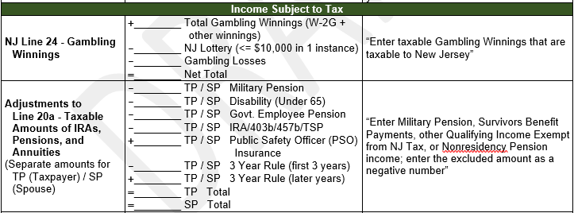
Disability Pension
NJ – Not taxed if under 65 AND “permanent and total disability”; taxed otherwise
If not taxable for NJ, record 1099-R Box 2a amount as adjustment to Line 20a on NJ Checklist. Note that amount is negative

Slide 49
Gambling Winnings: NJ Considerations
Losses are deducted from winnings before reporting the net gambling winnings on NJ 1040 Line 24
NJ Lottery winnings of $10,000 or less in a single instance are not taxable in NJ
For NJ lottery winnings above $10,000 in a single instance, total amount is taxable
Lottery winnings from other states and winnings from other types of gambling are taxable

Slide 50
Gambling Winnings: NJ Considerations
In TaxSlayer, entries made on Federal W-2G screen do not flow through to the NJ return
On NJ Checklist, subtract all gambling losses and NJ lottery winnings < $10K from total gambling winnings
Report net gambling winnings on NJ 1040 Line 24 only if the net is greater than $0 (no net loss)

Slide 51
Non-W2G Gambling Winnings: NJ Considerations
Gambling winnings not reported on a W-2G form should be reported on “Other Income” screen on Federal return
“Other Income” amounts flow from Federal to NJ 1040 Line 26. Since net gambling winnings are reported on NJ Line 24, non-W2G winnings must be subtracted from Line 26
Capture on NJ Checklist

Slide 52
Cancellation of Credit Card Debt
Amount of canceled credit card debt is not taxable in NJ
TaxSlayer does not allow canceled credit card debt reported as “Other Income” on Federal return to flow through to NJ return
No need for any entries on NJ Checklist

Slide 53
EIC Considerations for NJ
Residents who are eligible & file for Federal EIC may also apply for a NJ EITC
Client may have Federal earned income, but no NJ earned income (e.g. – disability, third-party sick pay). Still eligible for NJ EITC
NJ EITC = 39% of Federal EIC for TY2019
TaxSlayer calculates automatically on NJ 1040 Line 56
Before issuing refund checks, NJ checking EITC claims carefully to reduce fraud

Slide 54
Questions
Answer Baker questions 14 - 15

